Slide 1
Which drug is associated with the highest suicide rate?
Group A: Patrick Ging, Alejandro Alonso, Zoe Kuehne, Jenny Liu, Malem Ashem, Kevin Li, Alex Cho, Justin Zou
Notes:
patrick

Slide 2
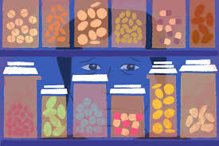
Introduction
Hypothesis: If the dependence on a drug increases, then the likelihood of suicidal thoughts or actions increases.
From general knowledge, we know opioid painkillers can be extremely addictive. As a result, the users will continuously suffer from the detrimental side effects, increasing suicidal thoughts and actions. Therefore, we believe we can conclude a positive correlation between addictiveness and suicidal thoughts in populations.
Notes:
People presenting this slide: Patrick(hypothesis), Zoe(explanation)

Slide 3
In this presentation:
We will introduce some background information on drug usage nationally from 2002-2016.
We will then move on to 2016, provide the sample size of our data, and examine the eight-most popular recreational drugs individually and their relationship to suicide rates to determine which one may make the most impact.
We will determine whether or not our original hypothesis correlating drugs and suicidalness was correct.
Notes:
People presenting this slide: Jenny

Slide 4
Background Information
Notes:
malem

Slide 5
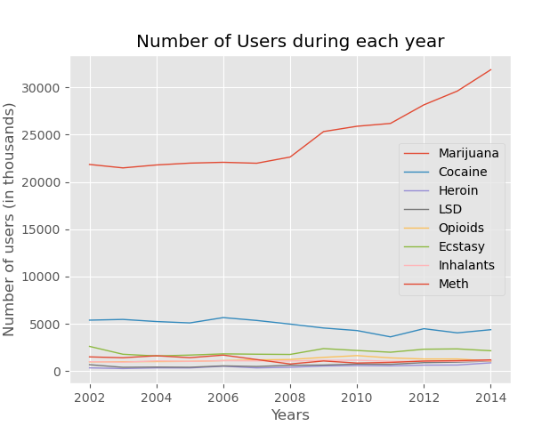
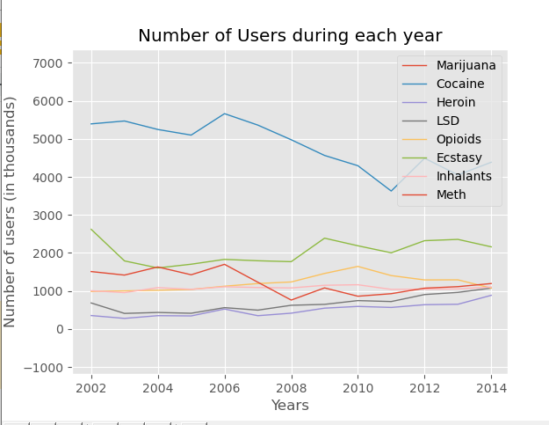
Line Graph: # of New Users from 2002-2016
We compared drug use from 2002-2016 to gain a holistic understanding of the number of users.
We see a dip in 2008, most likely due to recession
Notes:
Talks about new users each year compared to life time. There was a dip in drugs due to 2008 recession
People presenting- Justin

Slide 6
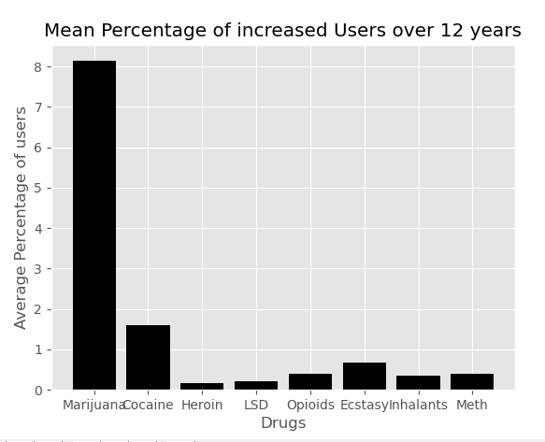
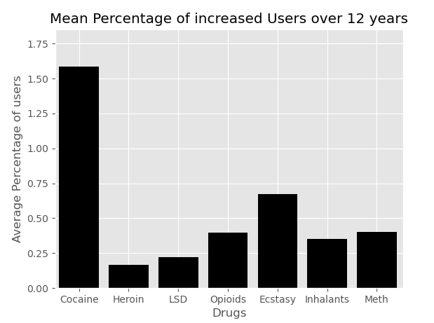
We see that the average percentage of new users are very low, with most less than 1%
Notes:
Whos presenting; justin

Slide 7
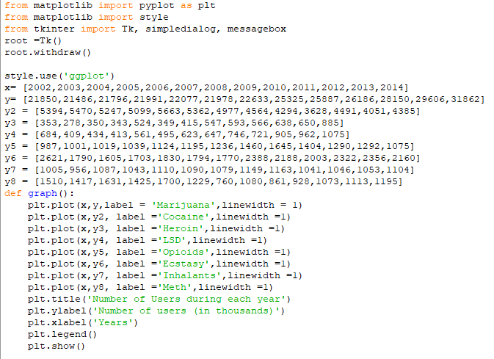
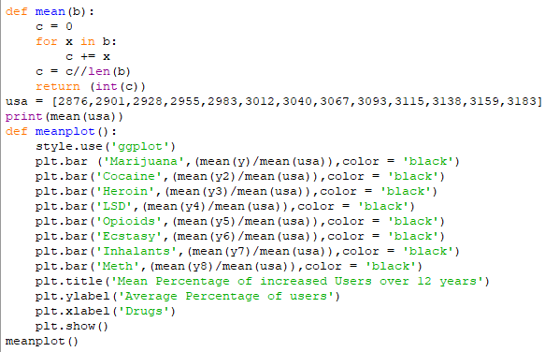
Code for New Users
Data found on the national drug survey from 2002 to 2014
Code for mean
Notes:
Justin

Slide 8
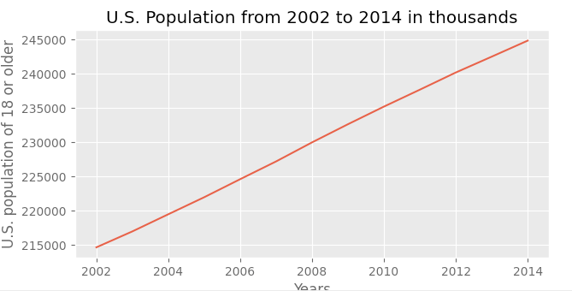
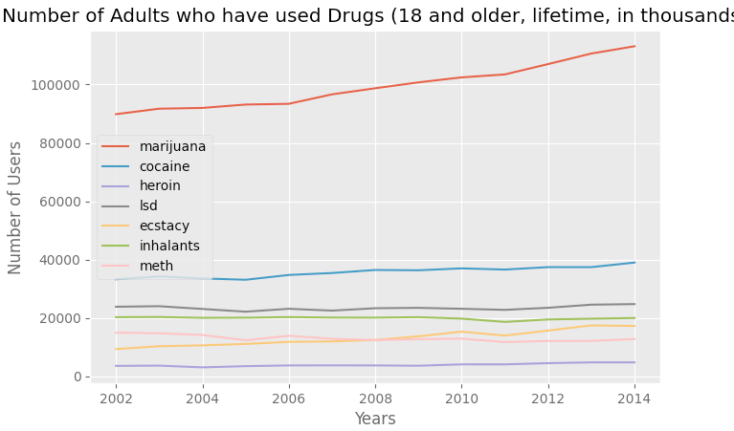
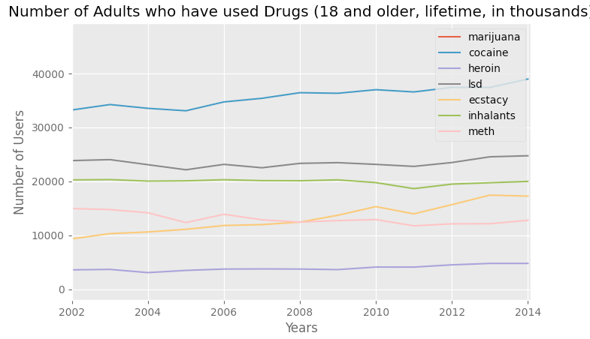
Line Graph of drug users (lifetime)
Notes:
Whos presenting- kevin

Slide 9
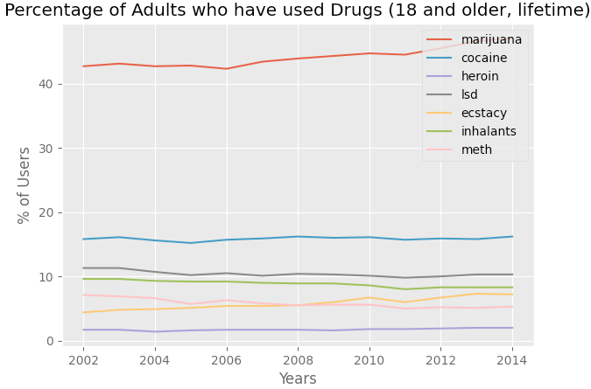
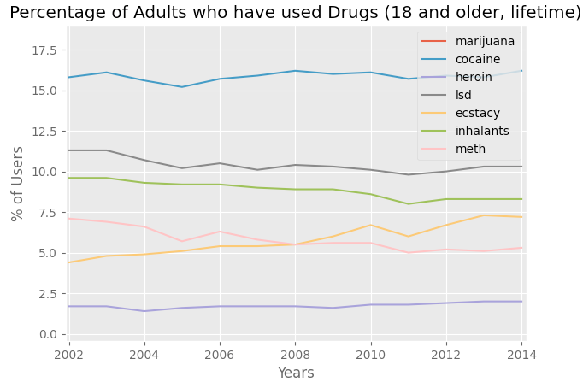
% of Adult Population in U.S. that have used each drug
Notes:
kevin

Slide 10
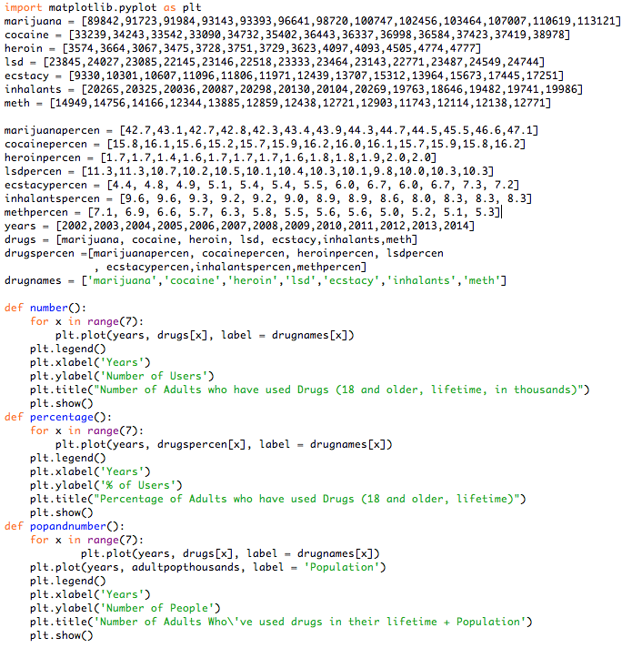
Code for Lifetime graphs
Data we found from National Drug Survey.
The data from each year was put into a list for each drug. All of the lists were put into another list so that the for loop could iterate through and and plot each line quickly
Notes:
Kevin presents

Slide 11
Number of User Conclusions
We see a general trend of the stagnation of drug usage or decreases
We see Marijuana usage spiking, but most likely due to how it is becoming legalized in more US states over time
We see that the lifetime graphs have large amount of users but when looking at the amount of users per year we see a much lower amount showing how drug usage has slowed prior to 2002
Inhalants and meth show good trends. The % of inhalant users dropped from 9.6% to 8.3% and from 2002 to 2014. While the adult population increased ~30,000, the number of users steadily dropped ~300. As for meth, the number of users dropped ~2200 (from 7.1% to 5.3% of pop ) which is a good sign as it has the highest % of suicidal tendencies in users (later in the presentation)
% of heroin users increased by .3%. Although it isn’t much, it’s still concerning as it is the drug with the 2nd highest in % of users with suicidal tendencies.
Ecstasy nearly doubled in % of adult users, from 4.4% to 7.2%. It’s growing popularity is also a cause for concern.
Notes:
Justin

Slide 12
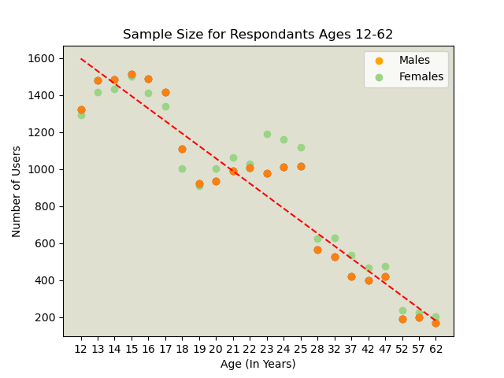
Scatter Plot
Taking a closer look at the year 2016 specifically, this demonstrates the relationship between age and drug usage.
This is the sample size we used for analyzing each individual drug’s effect.
Line of Best Fit
r = -0.9234
r^2 = 0.8527
Notes:
We should add the R correlation factor here. It’s most likely going to be extremely low…
Zoe and Jenny and patrick

Slide 13
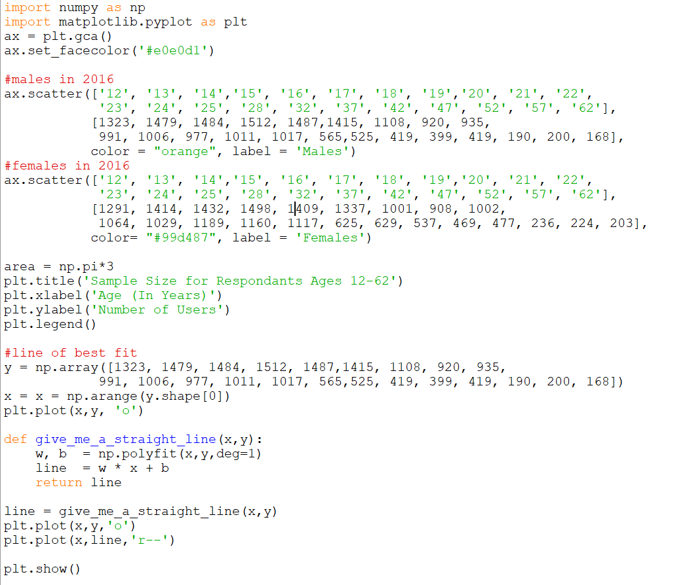
Scatterplot: Code
Necessary for plotting multiple datasets on same graph
Helps fit the line to the graph as needed
Needed helper function from above
Notes:
Zoe and Jenny

Slide 14
Scatter Plot conclusions
The r value shows how strong the correlation is with the line of best fit.
Although it’s not a causal relationship, our r value shows a strong negative correlation between age and the number of drugs users, that is the older someone gets, the less drugs they do. (This isn’t perfect as there is notable variance, but the trend still holds true).
In teenagers (12-19), generally there were higher counts of male drug users reported. However from 19-62, it’s mostly women. Now why this is the case is unclear, but it does appear to be negligible.
Men and women tend to use the same amount. Perhaps gender is not a factor in suicide rates or usage.
This hints that suicide rates may be more dependable and concentrated towards young and middle-aged people than elderly people.
Notes:
Jenny, patrick for the negligible point

Slide 15
Looking at Individual Drugs
Notes:
malem

Slide 16
What is Depression?
Depression is a common medical illness that negatively affects how you feel, the way you think and how you act. Depression symptoms can vary from mild to severe and can include:
Feeling sad or having a depressed mood
Loss of interest or pleasure in activities once enjoyed
Loss of energy or increased fatigue
Feeling worthless or guilty
Difficulty thinking, concentrating or making decisions
Thoughts of death or suicide
Abnormal chemical circuitry in the brain may contribute to symptoms of depression.
People with low self-esteem, who are easily overwhelmed by stress, or who are generally pessimistic appear to be more likely to experience depression.
Notes:
Zoe and patrick

Slide 17
Individual Drugs: Trends for Comparison
We selected the eight most popular recreational drugs to compare. Dataset from 2016 National Survey on Drug Use and Health.
We used pie charts to compare these trends within one drug.
# of Non-Suicidal Users (Total Users - Users with Thoughts, Plans, or Attempts)
# of Users with Serious Thoughts of Suicide
# of Users with Planned Suicides
# of Users with Attempted Suicides
Notes:
Jenny and Alex

Slide 18
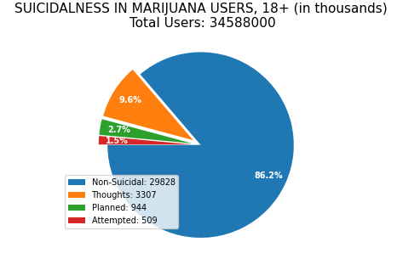
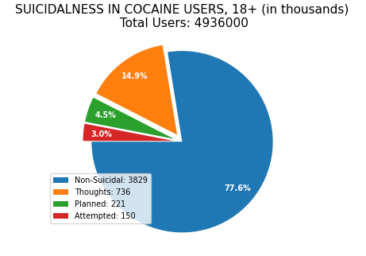
Marijuana and Cocaine
Notes:
Zoe and Jenny

Slide 19
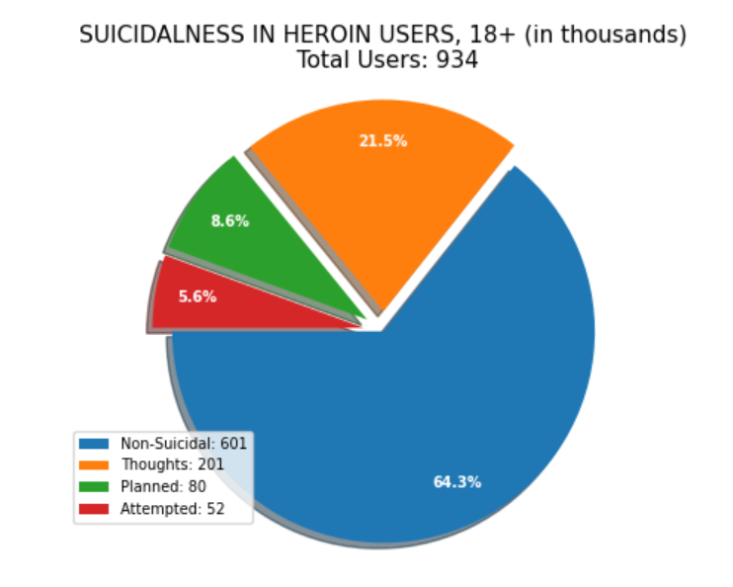
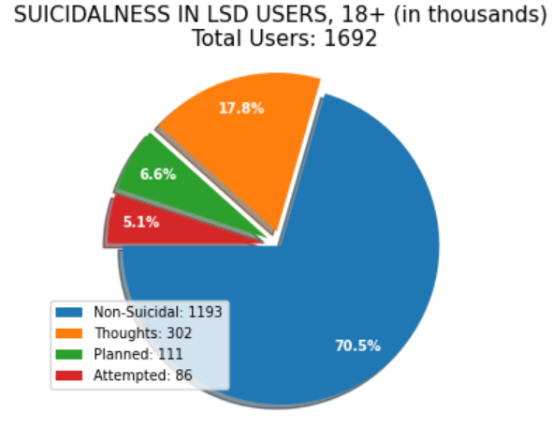
Heroin and LSD
Notes:
Patrick,

Slide 20
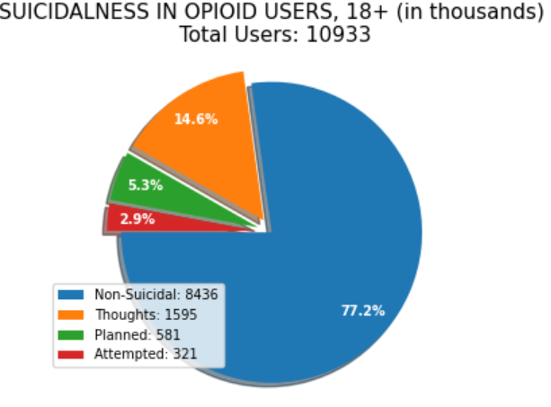
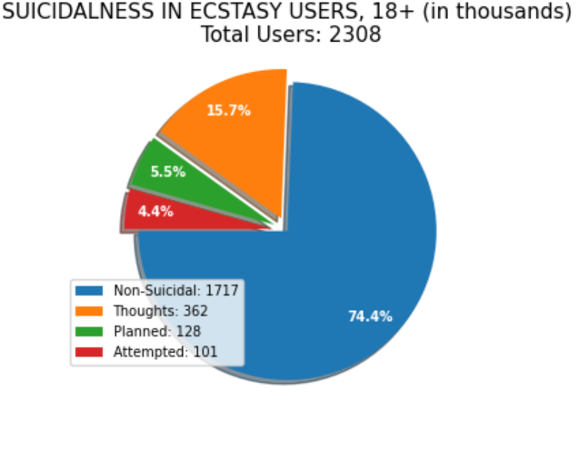
Opioids and Ecstasy
Notes:
Alejandro

Slide 21
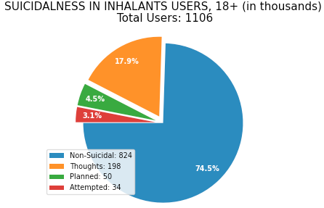
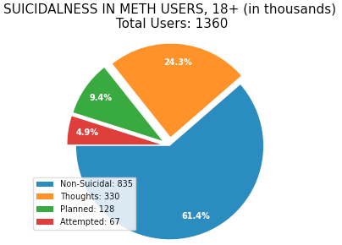
Inhalants and Meth
Notes:
Justin,

Slide 22
Statistics of Individual Drugs
Range Between Thoughts and Attempted and %:
Marijuana: 2798 (15%)
Cocaine: 586 (20%)
Heroin: 149 (10%)
LSD: 216 (29%)
Opioids: 1274 (20%)
Ecstasy: 261 (28%)
Inhalants: 164 (17%)
Meth: 263 (20%)
Even though number of users may decrease, the percentage of people who end up committing suicide could increase.
Name | Non-Suicidal | Thoughts | Planned | Attempted
Marijuana | 29,828 | 3,307 | 944 | 509
Cocaine | 3829 | 736 | 221 | 150
Heroin | 601 | 201 | 80 | 52
LSD | 1193 | 302 | 111 | 86
Opioids | 8436 | 1595 | 581 | 321
Ecstasy | 1717 | 362 | 128 | 101
Inhalants | 824 | 198 | 50 | 34
Meth | 835 | 330 | 128 | 67
Notes:
Patrick and Alex

Slide 23
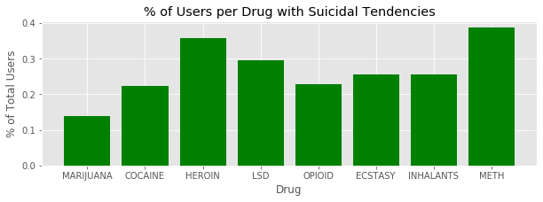
BAR GRAPH
Meth has the highest % of suicidal tendencies
Despite having a lower number of users
Highest % of users has the lowest % of suicidal tendencies
Notes:
Alejandro

Slide 24
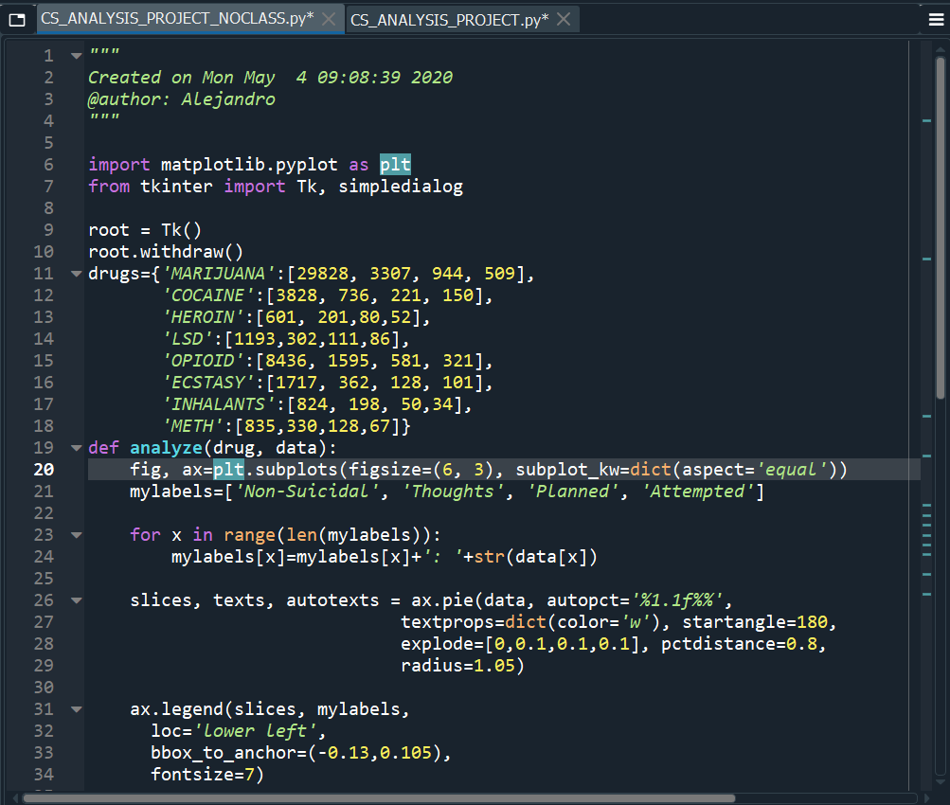
C
O
D
E
Notes:
Alejandro

Slide 25
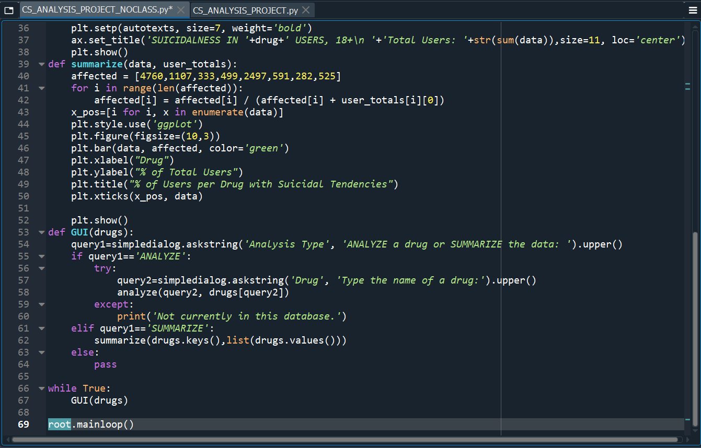
C
O
D
E
Notes:
alejandro

Slide 26
Suicidal tendency Conclusions
The conclusion that we drew from the graph was…
Heroin and Methamphetamine were the most mentally damaging drugs with about forty percent of users having seriously thought about ending their lives or attempted to
Marijuana had the least unhealthy impact on its users due to it being weaker than the other drugs. However about fifteen percent of its users were still negatively impacted mentally
Marijuana was the only drug with a below twenty percent suicidal tendencies rate, proving that all of the other drugs that we tested led to twenty percent of its users developed suicidal tendencies
Opioids and stimulants also highly affected its users due to their addictive nature, its users relied on the drug therefore putting them at risk for mental illness
Notes:
I think we can mention how marijuana had more people so even though the percentage was low, users were high
Zoe, Malem

Slide 27
Final thoughts and conclusions
Both Methamphetamine and Heroin have euphoric effects by going into your brain and affecting your mood, making them both highly addictive.
Heroin enters the brain rapidly, attaching themselves to opioid receptors, the areas of pain and pleasure. When heroin attaches onto the receptors, it stimulates the release of dopamine (a neurotransmitter that has the feeling of happiness)--creating a feedback loop where the user would abuse the drug more often.
Methamphetamine similarly increase activities in the central nervous system and parts of the brain increasing energy and pleasure (the release of dopamine).
These are shared traits with stimulants, opioids, and inhalants which all go into your brain trying to increase energy (stimulants), cause pain relief (opioids) and to get an euphoric high (inhalants).
Marijuana also lead to highs and affect the brain, but it is actually considered less harmful than alcohol when used recreationally, as alcohol is a poison when consumed in large amounts.
Notes:
Justin

Slide 28
Did It Support The Hypothesis?
We believe that our hypothesis was ultimately correct.
Drugs that highly affect your central nervous systems or parts of your brain show increase signs of addictiveness and the more addictive it is, the higher the suicidal tendencies.
Notes:
Jenny

Slide 29
Interesting Facts
Unlike the drugs that increased rates of suicide in its users such as heroin, marijuana has no known harmful effects to the adult human body whatsoever, due to its nature as one of the weaker psychoactive drugs. This would help in explaining why it had such a low correlation with suicidal thoughts or actions, as marijuana helps with stress relief with its “high”.
Marijuana also has a wide variety of potential medical usage. There is research that indicates that THC, a compound in marijuana, can stop the growth of blood vessels that feed cancerous growths, delaying/stopping tumors from forming in the first place. Not only that, THC is thought to ease inflammation and control spasms/seizures due to its nature as a relaxant. THC also eases the symptoms of glaucoma, since it reduces pressure built in the eyes.
Compared to this, Heroin has a multitude of side effects, such nausea, vomiting, and severe itching. Additionally, heroin’s effect of slowing down the heart rate could be so severe, it may leave its users in a coma.
Notes:
Malem and Alex

Slide 30
Sources
Source: Substance Abuse and Mental Health Services Administration
https://www.samhsa.gov/data/sites/default/files/NSDUH-DetTabs-2016/NSDUH-DetTabs-2016.pdf
https://datacenter.kidscount.org/data/tables/99-total-population-by-child-and-adult-populations#detailed/1/any/false/869,36,868,867,133,38,35,18,17,16/39,40,41/416,417
https://www.samhsa.gov/data/sites/default/files/NSDUH-DetTabs2014/NSDUH-DetTabs2014.pdf
https://www.socscistatistics.com/tests/pearson/default2.aspx
https://www.drugabuse.gov/publications/research-reports/heroin/what-are-immediate-short-term-effects-heroin-use
https://www.drugabuse.gov/publications/drugfacts/marijuana

